Slide 1
EXPLORATORY DATA ANALYSIS

Slide 2
Exploratory Data Analysis
- Exploratory Data Analysis (EDA) serves as the cornerstone of any data-driven project, playing a pivotal role in unraveling the complex patterns and insights hidden within datasets
- EDA is indispensable in extracting actionable insights from raw data, especially in domains like real estate where numerous factors contribute to the final property value.

Slide 3
Tasks:
Loading and Cleaning the data
Univariate analysis
Multivariate analysis
Feature Engineering
Libraries used :
Pandas, Numpy, Matplotlib, Seaborn, Scipy

Slide 4
loading and cleaning datas:
data = pd.read_csv('housing_data.csv')
data.info()
Get the information about the data, whether its integer, float or string
data.describe()
data.isnull().sum() - find the null values
data.dropna(inplace=True) - drop the null values

Slide 5
Univariate analysis:
Histogram
plt.hist(data['LotArea'], bins = 10)
plt.title("histogram of area")
plt.xlabel("LotArea")
plt.ylabel("Range")
plt.show()

Slide 6
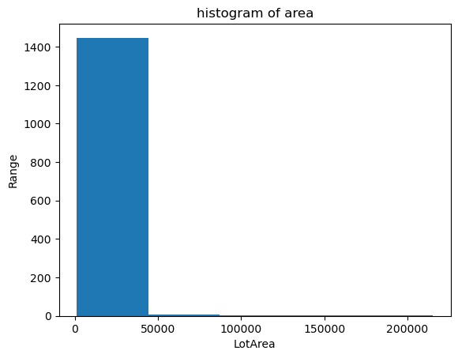
HISTOGRAM, bins = 5 (intervals)

Slide 7
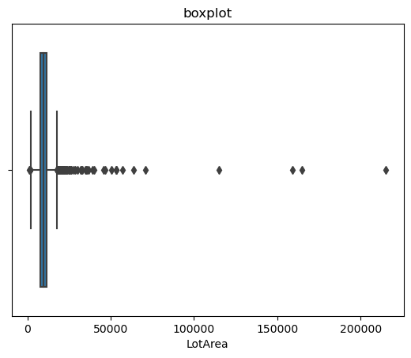
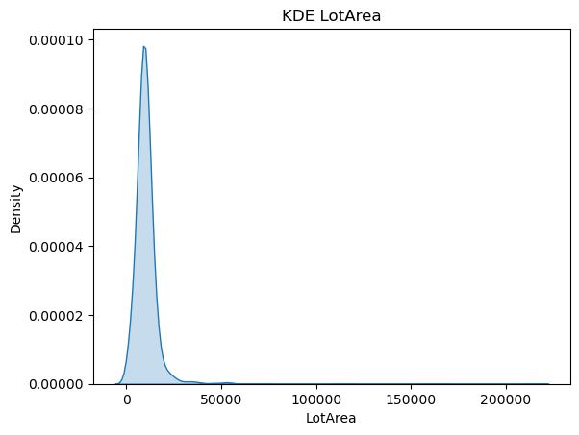
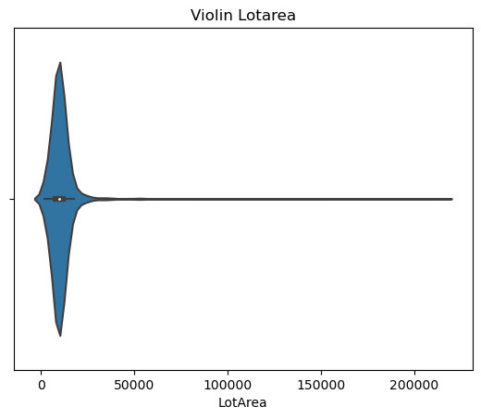
box plot, KDE plot, violin plot

Slide 8
Multivariate analysis:
Correlation (relation between the variables)
correlation_matrix = data.corr()
sns.heatmap(correlation_matrix, annot=True, cmap='coolwarm')
plt.title('Correlation Heatmap')
plt.show()

Slide 9
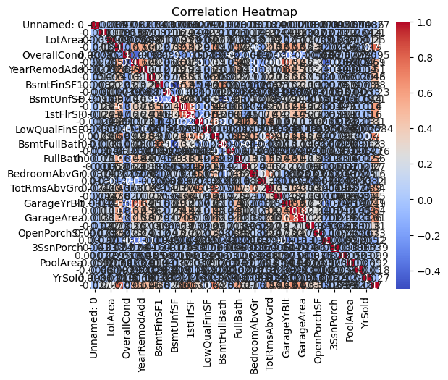
Correlation:

Slide 10
Feature engineering:
Process of selecting, transforming or creating new features from the raw dataset for improving the machine Learning model
Techniques:
Feature selection
Feature scaling
Feature Transformation
Handling missing values
Encoding the categorical variables
Feature aggregation

Slide 11
Feature selection:
selected_features = ['LotArea','YearBuilt']
data_selected = data[selected_features]
Explain: Two areas selected - Lot area and Area built

Slide 12
Feature Aggregation
data_aggregated = data.groupby('LotArea').agg({'YearBuilt': 'mean', 'YearRemodAdd': 'count'})
Explaination: lot area - year built (mean) * YearRemodAdd(count)

Slide 13
Thank You

